Slide 1
Netflix Data Analysis using Python
Presented by :- Samarth Chhabra
Date :- 18-09-2025

Slide 2
Project Overview!
Project Objective: Analyze Netflix’s content library using Python to uncover patterns in genres, countries, content types, and release trends.
Scope: Covers both movies and TV shows, examining metrics like genre, director, country, and rating.
Key Tools: Python (pandas, matplotlib, seaborn), visualizations (bar charts, word clouds).
Focus Areas:
Distribution of content types and genres
Major contributing countries
Content addition trends over time
Insights into ratings and directors

Slide 3
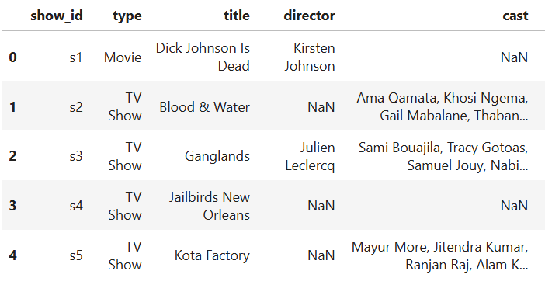
Dataset Description
🔢📂 Source: Kaggle – Netflix Movies & TV Shows Dataset
Total Records: 8,807 entries
📅 Time Range: 1925 – 2021
📊 Key Columns:
🎬 Title
🎥 Type (Movie / TV Show)
⭐ Rating
📌 Genre (listed_in)
🌍 Country
➕ (Other details: director, cast, description, duration…)

Slide 4




Tools & Libraries
🐍 Python – Core programming language
📊 Pandas – Data cleaning & manipulation
🔢 NumPy – Numerical operations
📉 Matplotlib & Seaborn – Data visualization
📈 Plotly – Interactive charts
💻 Jupyter Notebook – Development environment

Slide 5
Data Pre-Processing
🗑 Handling Missing Values – Removed/filled null entries
📋 Removing Duplicates – Ensured unique records
📅 Date Formatting – Converted date_added into proper datetime
🔠 Standardization – Cleaned text fields (country, genre, etc.)
🎯 Filtering Columns – Selected only useful features for analysis

Slide 6


Visualization ….!!!

Slide 7
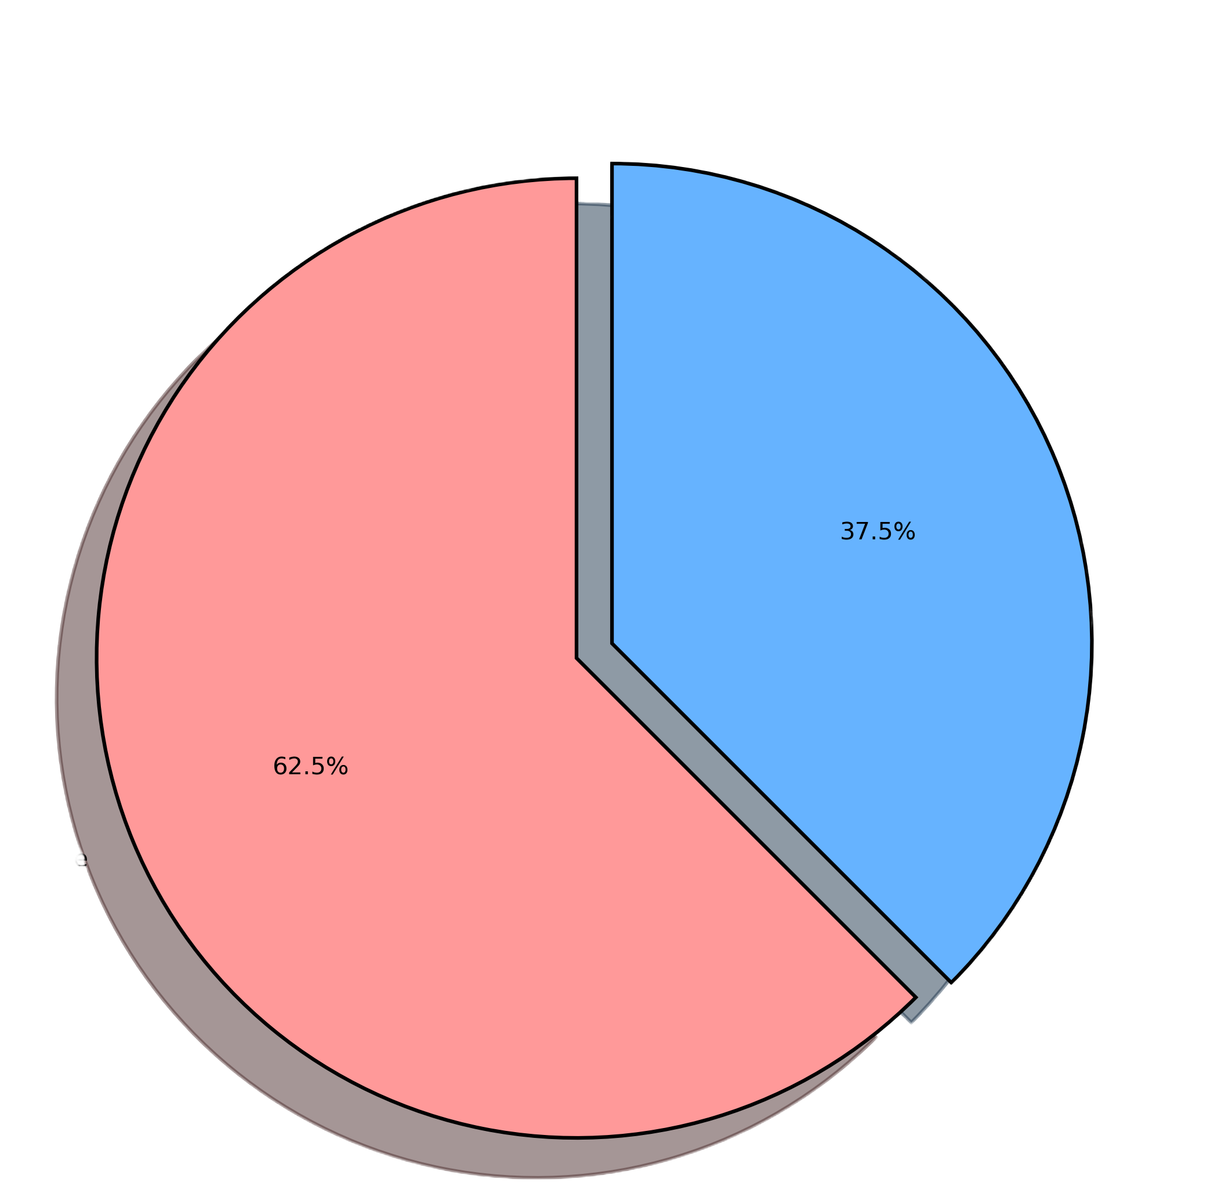
Movies Vs T.V Shows…!!!
🎬 Movies: 6,137 (~62.5%)
📺 TV Shows: 2,670 (~37.5%)
Insight: Netflix’s library is dominated by Movies.

Slide 8
Top Genres….!!!
🎭 Drama – 18%
😂 Comedy – 15%
👀 Documentary – 12%
😱 Thriller – 10%
💕 Romance – 8%

Slide 9
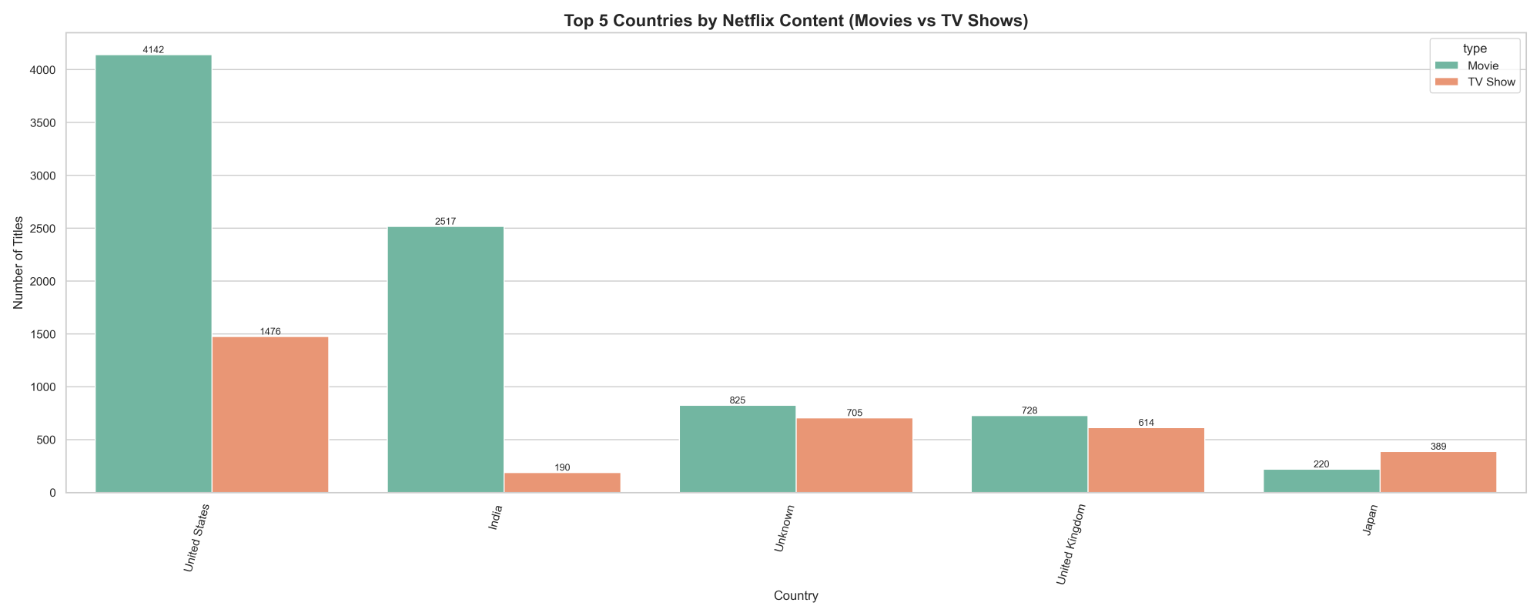
Content by Country
🇺🇸 32% – United States
🇮🇳 18% – India
🇬🇧 8% – United Kingdom
🇯🇵 5% – Japan
🌍 37% – Other Countries Combined (Use a Map or Bar Chart)

Slide 10
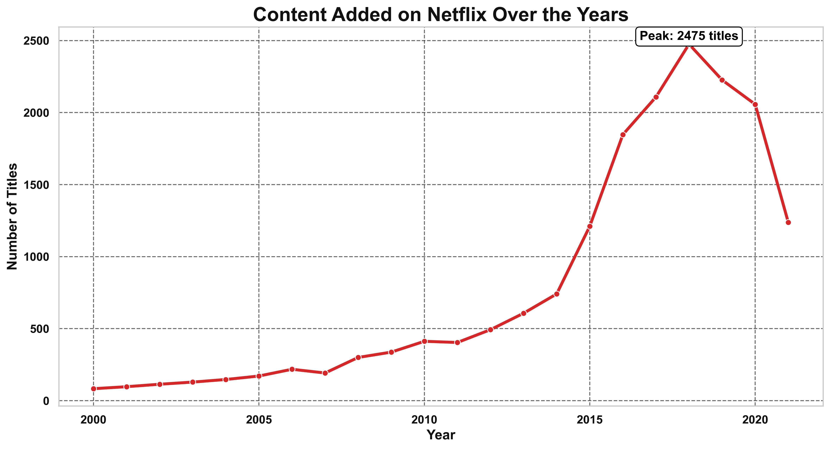
Content Growth Over Time
📅 Peak additions in 2019 (highest releases)
📈 Huge growth after 2015
🔻 Slight dip after 2020 (pandemic effect)

Slide 11
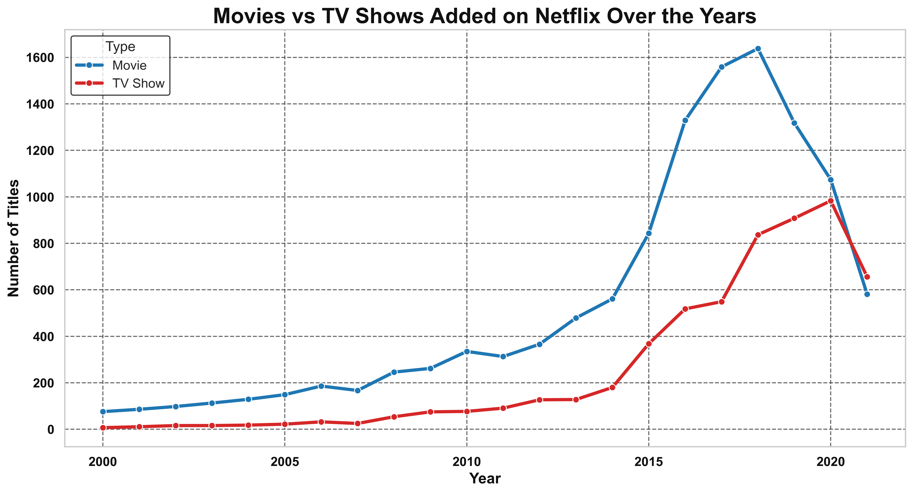
Movies vs TV Shows Trend Over Years
📅 Shows how Netflix shifted focus
🎬 Movies had steady growth
📺 TV Shows increased rapidly after 2015
🔍 Highlights strategy change in content

Slide 12
Rating Distribution!
Content:
Netflix uses different maturity ratings (TV-MA, TV-14, R, PG, etc.).
Majority of shows/movies fall under TV-MA (Mature Audience).
Helps understand audience target group.

Slide 13
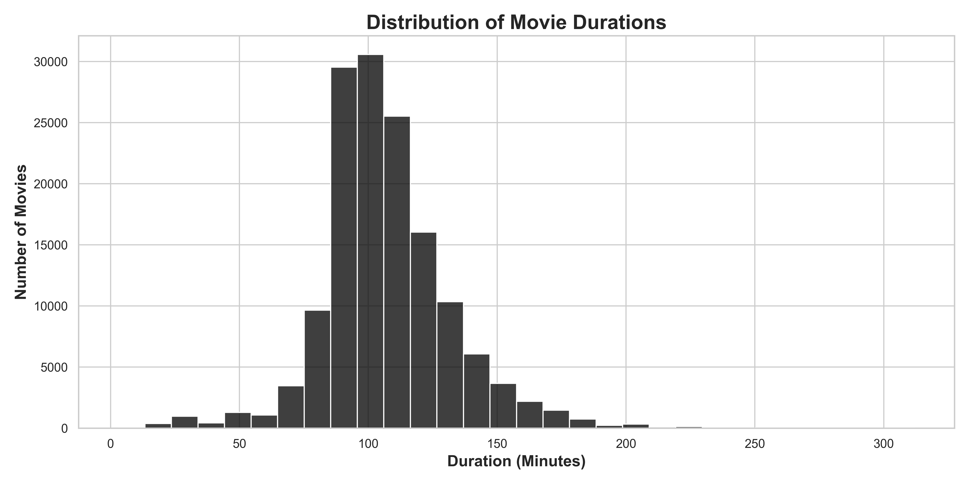
Duration Analysis (Movies)
Content :-
Movies on Netflix range widely in length.
Most movies fall between 90–120 minutes.
Very few movies are under 60 minutes or over 180 minutes.

Slide 14
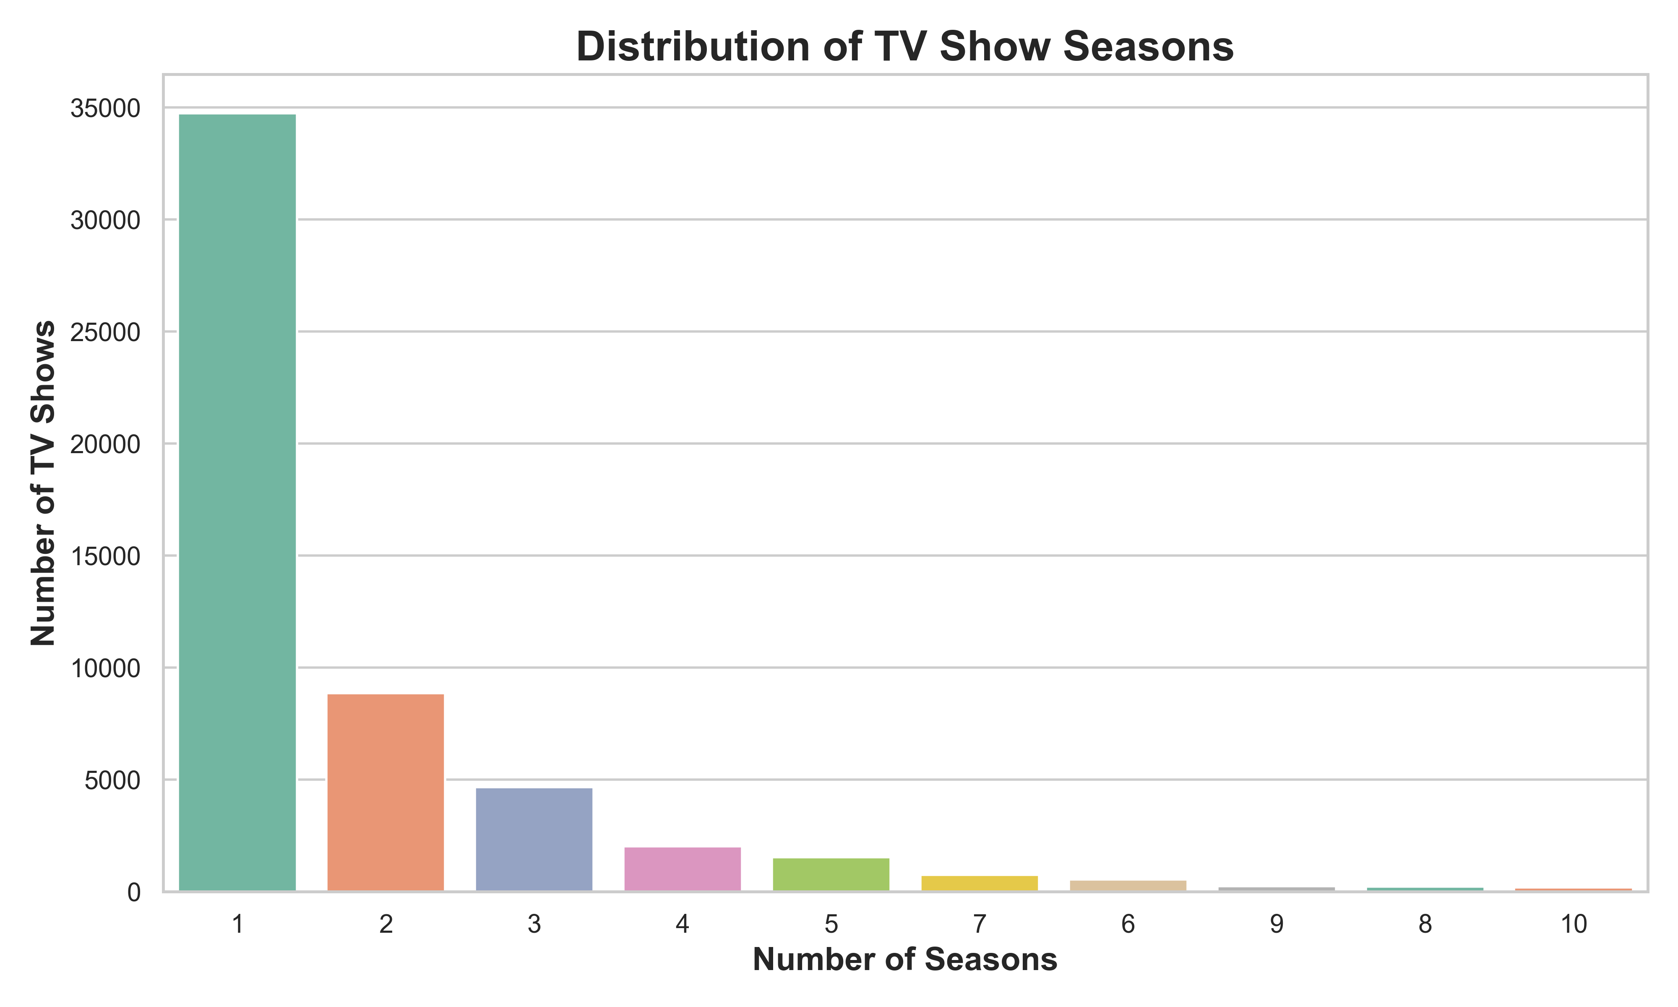
Visualizing 8: TV Show Seasons Distribution
Content:
TV Shows on Netflix vary in number of seasons.
Majority have 1–3 seasons.
Very few shows run for more than 10 seasons.

Slide 15
Key Finding
Content:
🎬 Movies make up ~70% of Netflix content.
📺 TV Shows have grown rapidly after 2015.
🌎 US and India are the top content producers.
🎭 Drama and Comedy dominate genres.
🔞 Majority of content is TV-MA (Mature Audience)

Slide 16
Conclusion & Future Scope
Content:
Netflix’s content strategy is shifting towards TV Shows & diverse genres.
2019 was the peak year of new additions.
Insights can help predict future content strategy.
Future work: sentiment analysis of descriptions, recommendations, or clustering genres.

